Slide 1
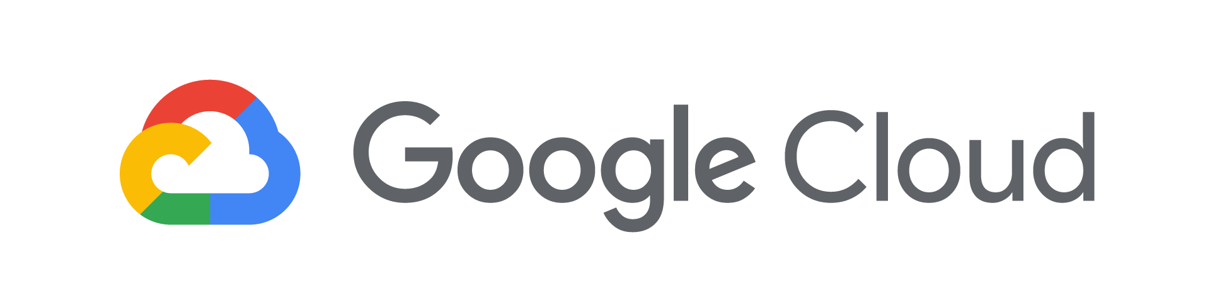
Big Data Analytics with Cloud AI Platform Notebooks

Slide 2

Agenda
What’s a Notebook
BigQuery Magic and Ties to Pandas

Slide 3
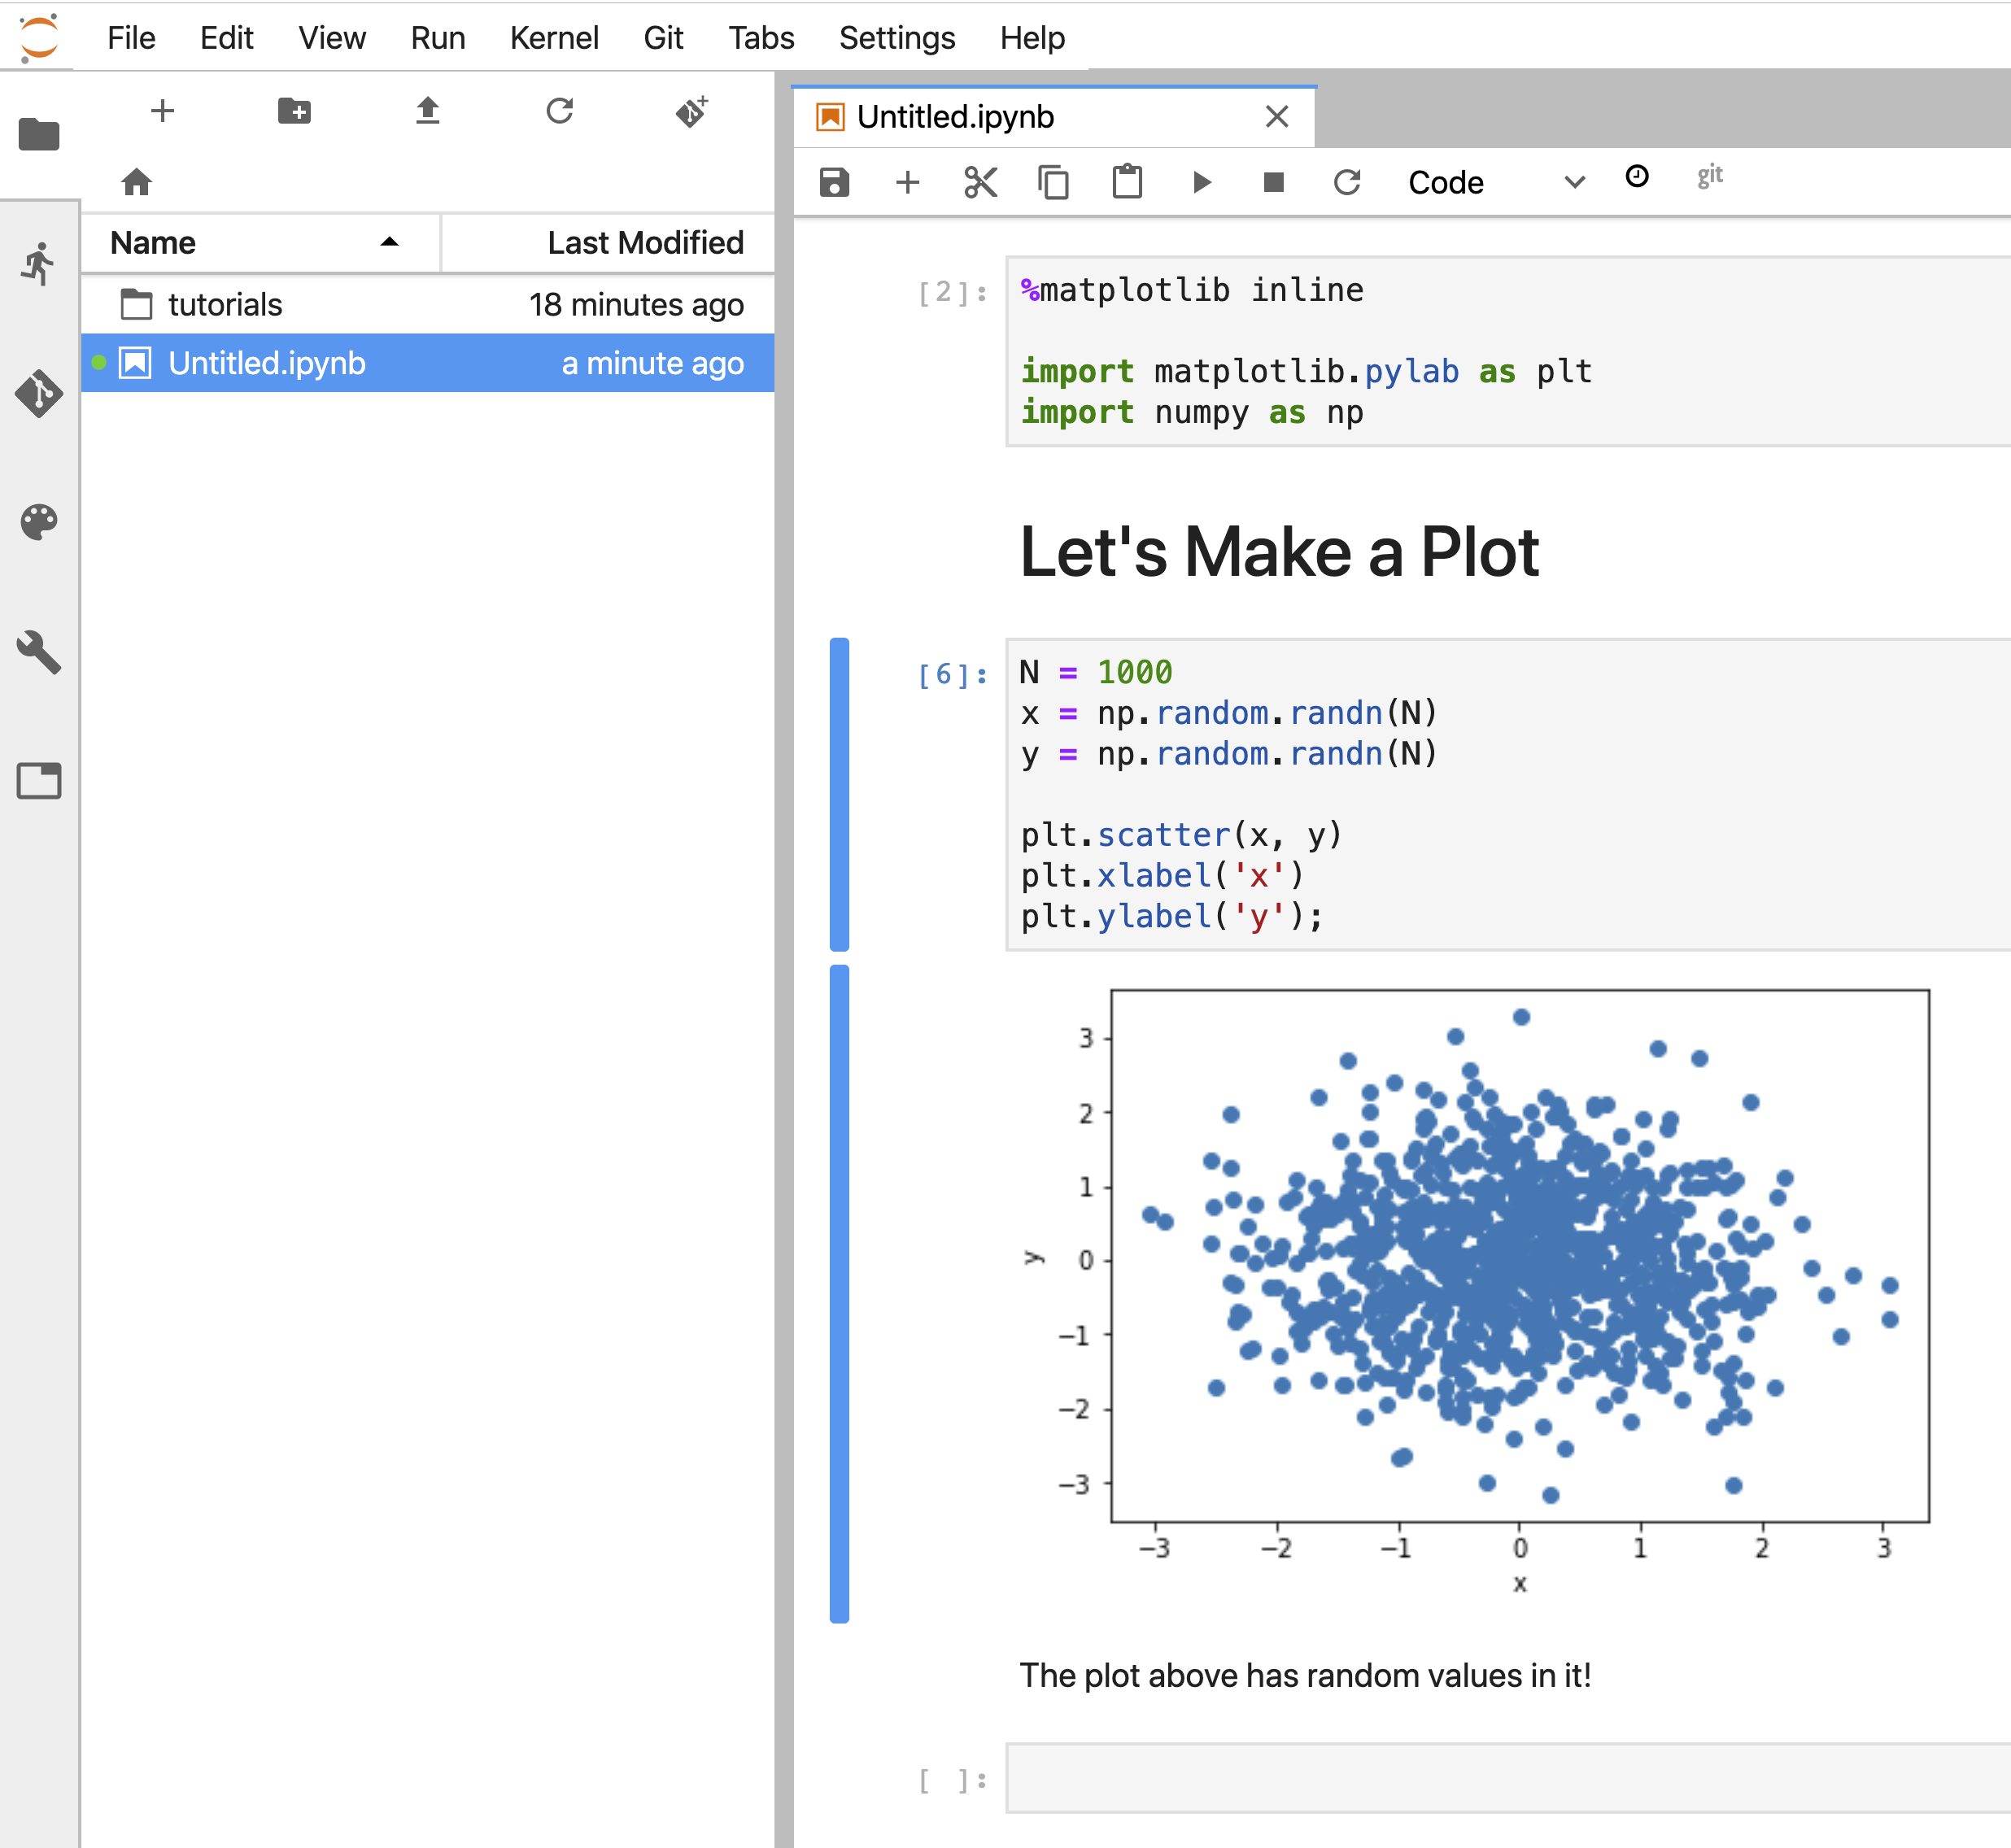
Increasingly, data analysis and machine learning are carried out in self-descriptive, shareable, executable notebooks
A typical notebook contains code, charts, and explanations
Share
Code
Output
Markdown

Slide 4
Notebooks are developed in an iterative, collaborative process
PHASE 5
Share and collaborate
PHASE 1
Write code in Python
2
5
1
Development Process in
Cloud Datalab
3
PHASE 4
Write commentary in markdown
PHASE 2
Run cell (Shift+Enter)
4
PHASE 3
Examine Output
Notes:
Have you used Google Docs? How is it different from documents edited in a desktop editor?
Have you filed taxes online? How is the experience different from doing your taxes in a desktop program?
There are lots of benefits, but one key aspect is collaboration. You don’t have to email documents back and forth.
When I first started doing scientific research, collaborating on a single result was painful. I’d write some code and create a graph. Then, I would snapshot, create an image file, put into a doc, create a PDF, and send it to my collaborator.
A few hours later, my colleague would say, “Looks great, but could you add one more year’s data? It looks kinda sparse.”
And I’d go through the process all over again. Why? Because the PDF I’d sent was not editable. Round-trips took a loooong time.
Enter Python notebooks. I’d write the code, create the graph, write some commentary, and send the notebook link to my colleague. This way, when my colleague wanted to add one more year of data, she would simply edit the cell, look at the new graph, and say, “See, it looks a lot better.” And that was great; we now had a better notebook for the next step.
One problem with traditional notebooks: Who runs the server that hosts these pages? Whose machine? If it’s mine, and my machine goes to sleep, then my colleague can’t work!
When your Datalab notebook is hosted in the cloud, you can develop together quite easily.
And just as Google Docs are available even when your computer isn’t on, so too are Datalab notebooks, when you run them in the Cloud.
To share a notebook *within* a project, other users can simply “datalab connect” to the VM and work using the URL. Another way to share notebooks is through revision control systems (for example, git).

Slide 5
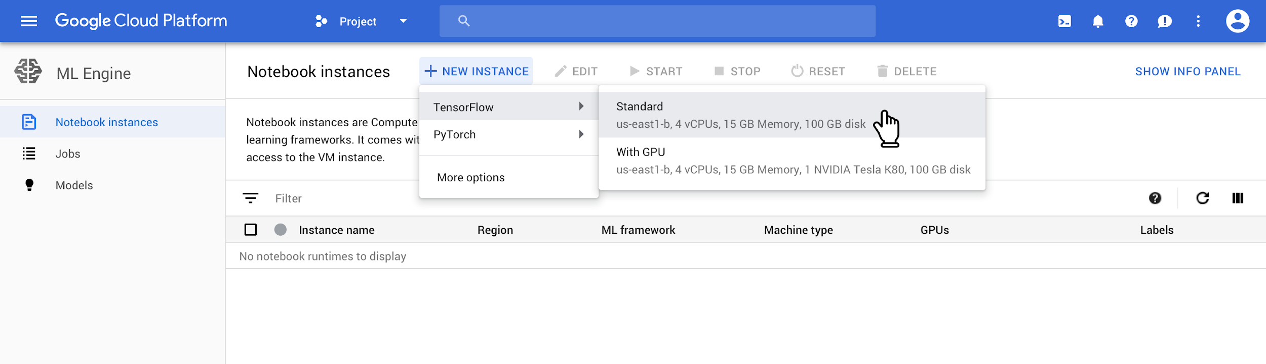
Spin up a JuypterLab instance, pre-configured with the latest machine learning and data science frameworks in one click.

Slide 6
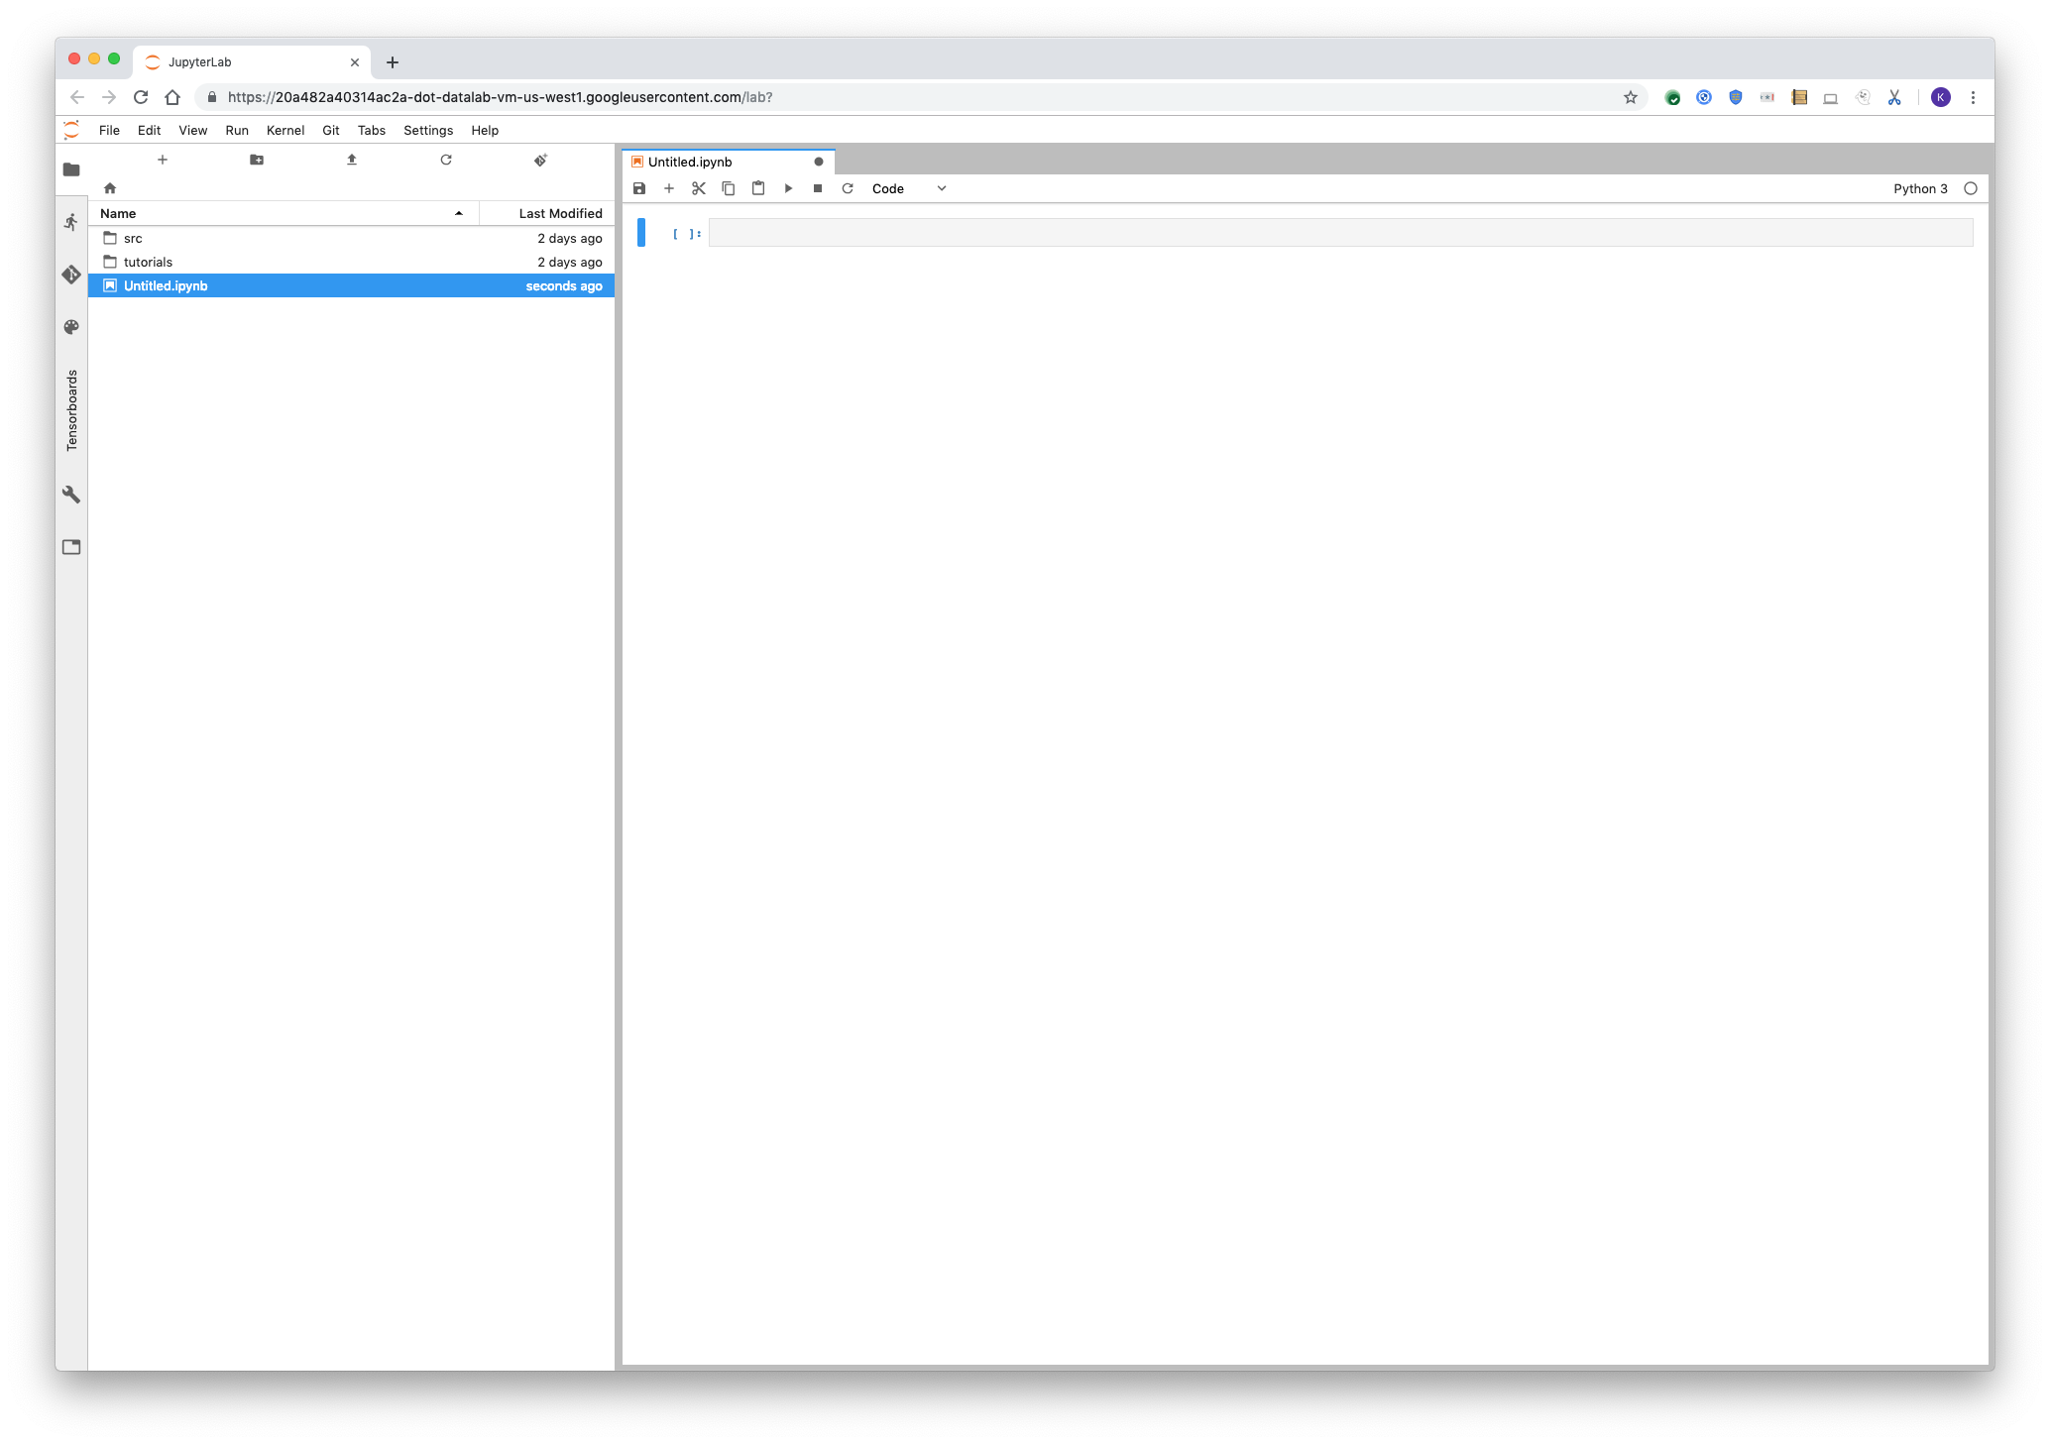
AI Platform Notebooks uses the latest open-source version of the industry-standard JupyterLab

Slide 7
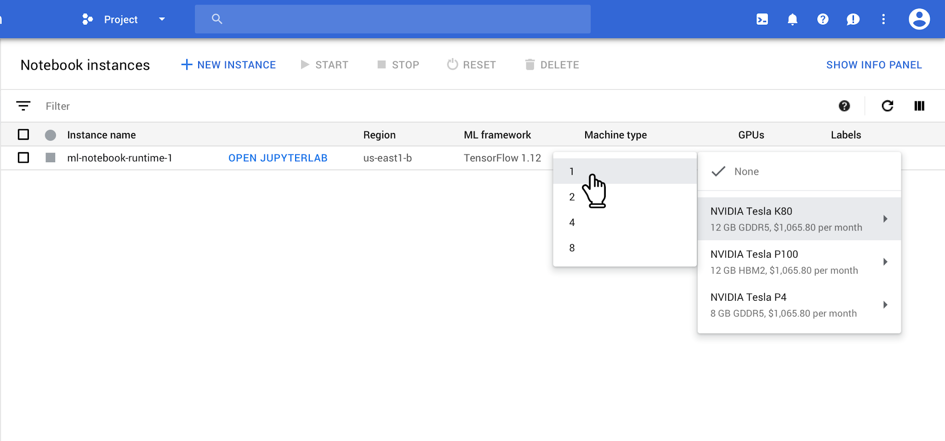
You can easily change hardware including adding and removing GPUs

Slide 8
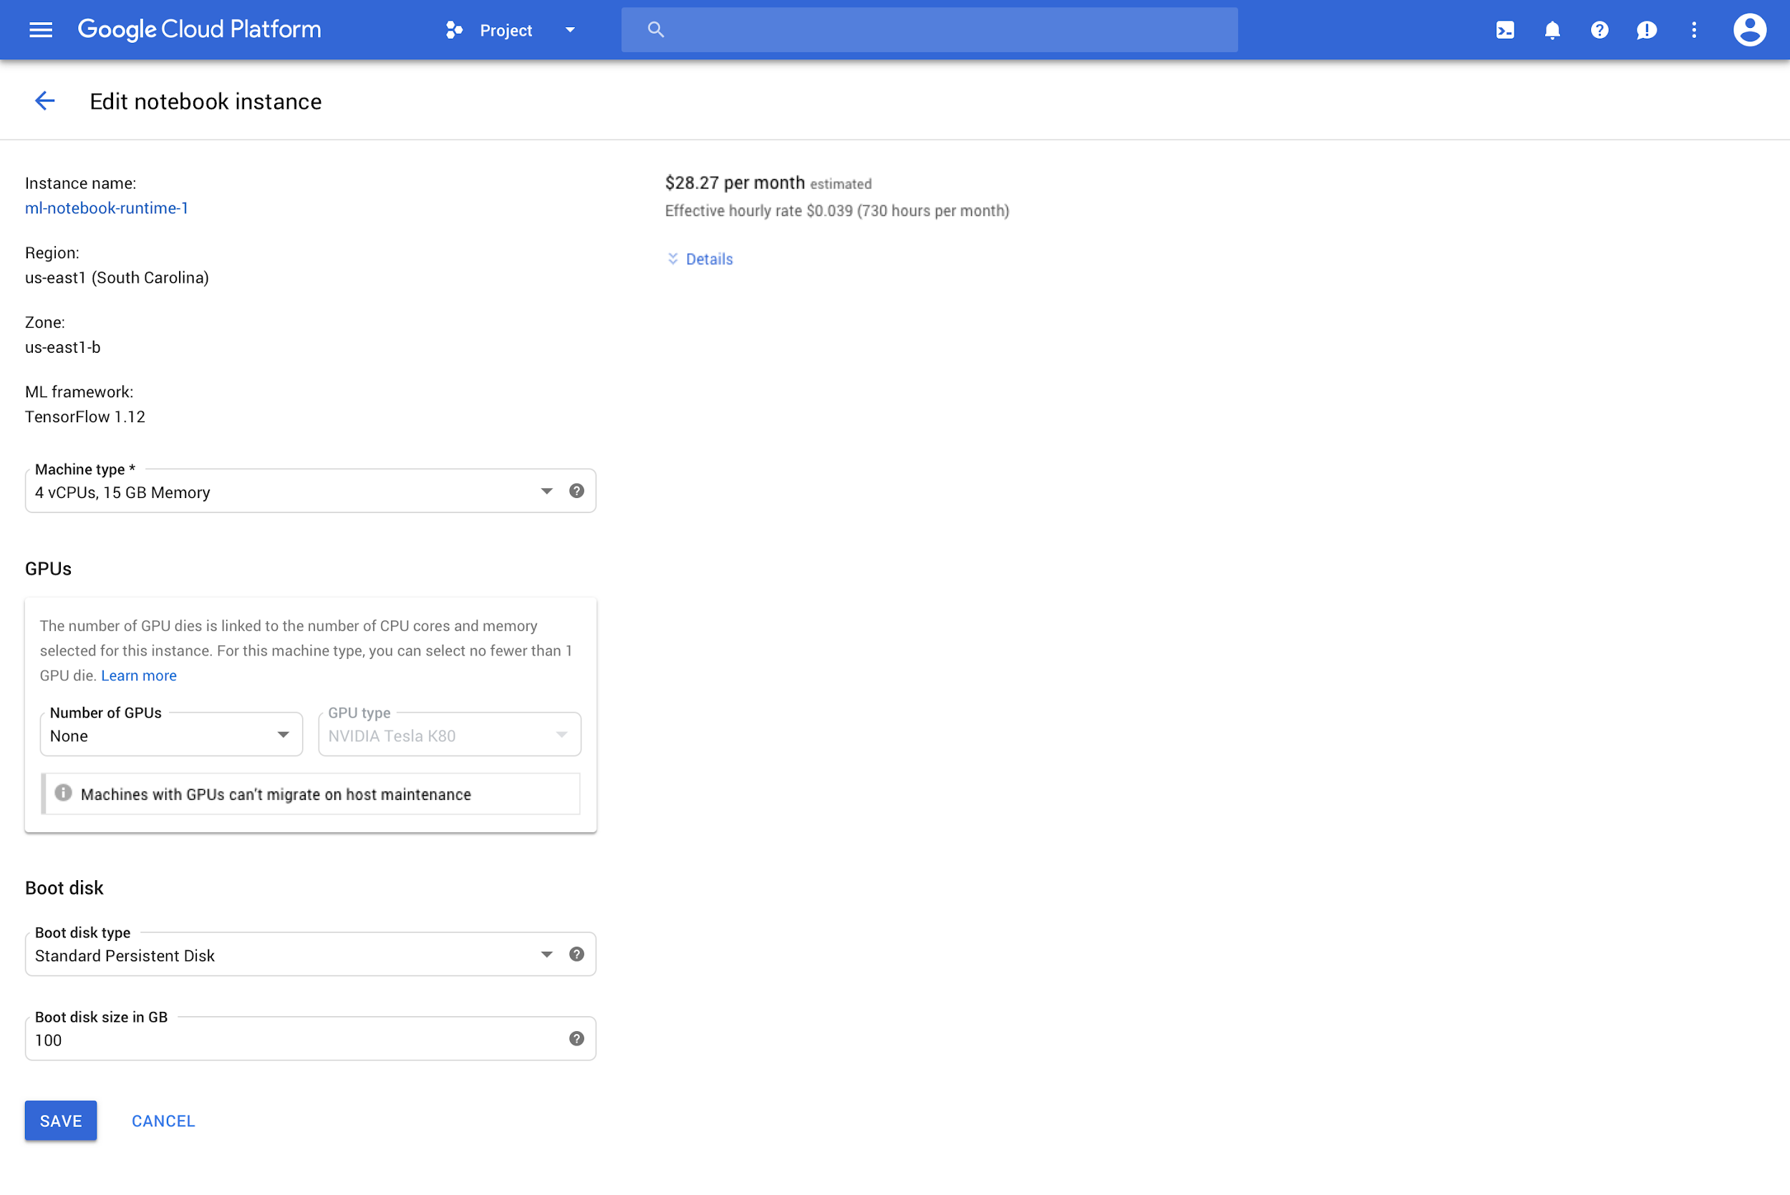
Use any GCE instance type. You can pick the hardware that makes sense, and scale up or down as needed

Slide 9
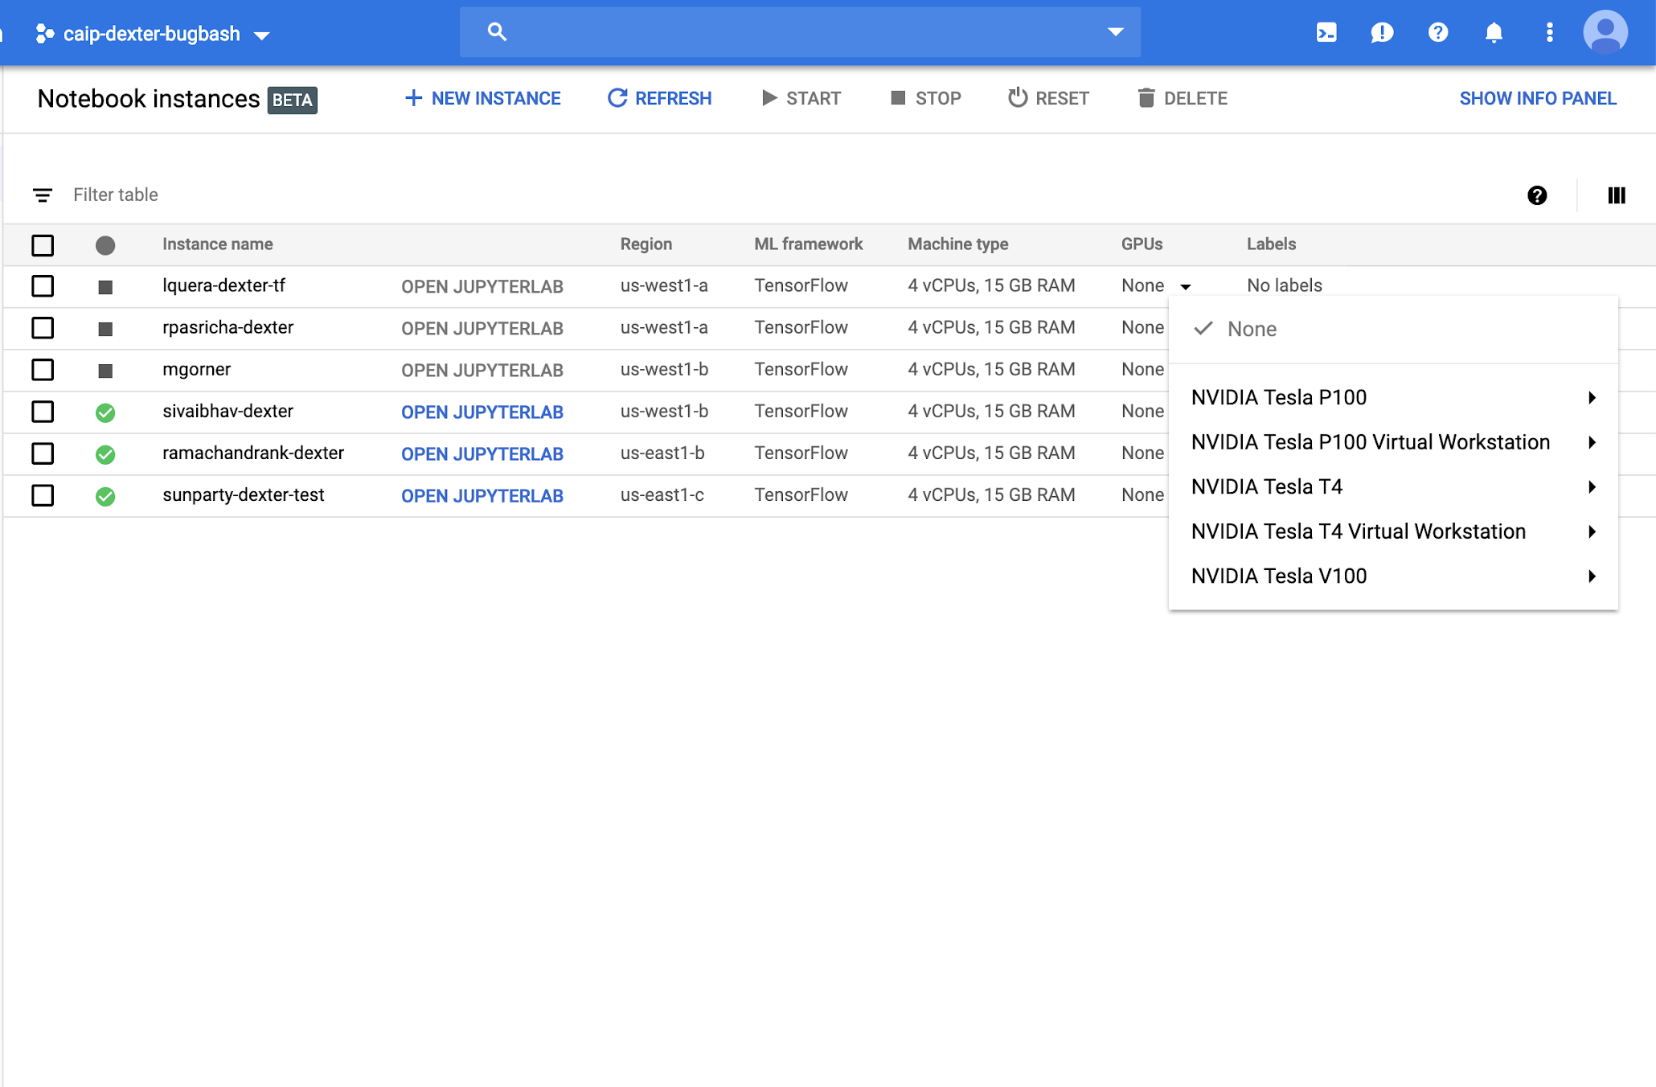
You can even add and remove GPUs

Slide 10
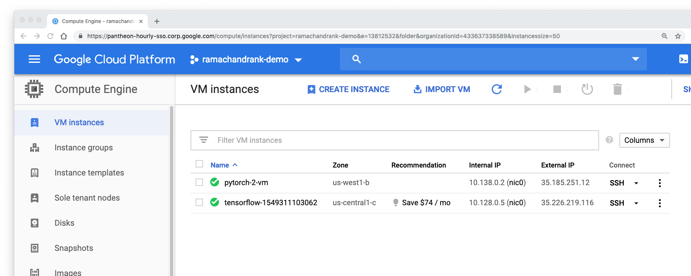
Notebook instances are standard GCE instances that live in your projects

Slide 11
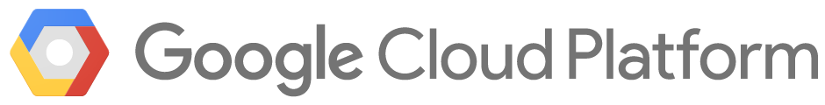


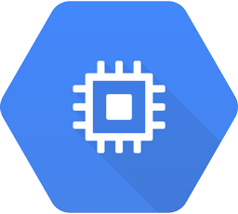
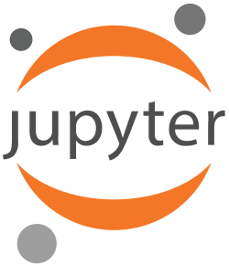

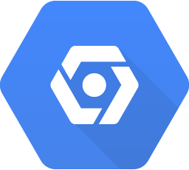
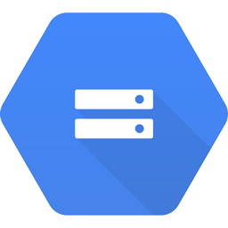
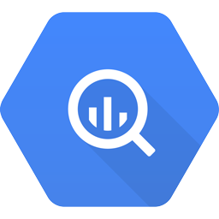
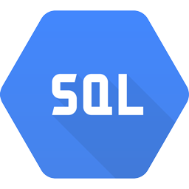
How does it work?
JupyterLab
Hosted on
DLVM - Compute Engine
Laptop
Pull/Push Code
Read/Write
Data
Notebook files Cloud repository
Data Sources

Slide 12
Agenda
What’s a Notebook
BigQuery Magic and Ties to Pandas

Slide 13
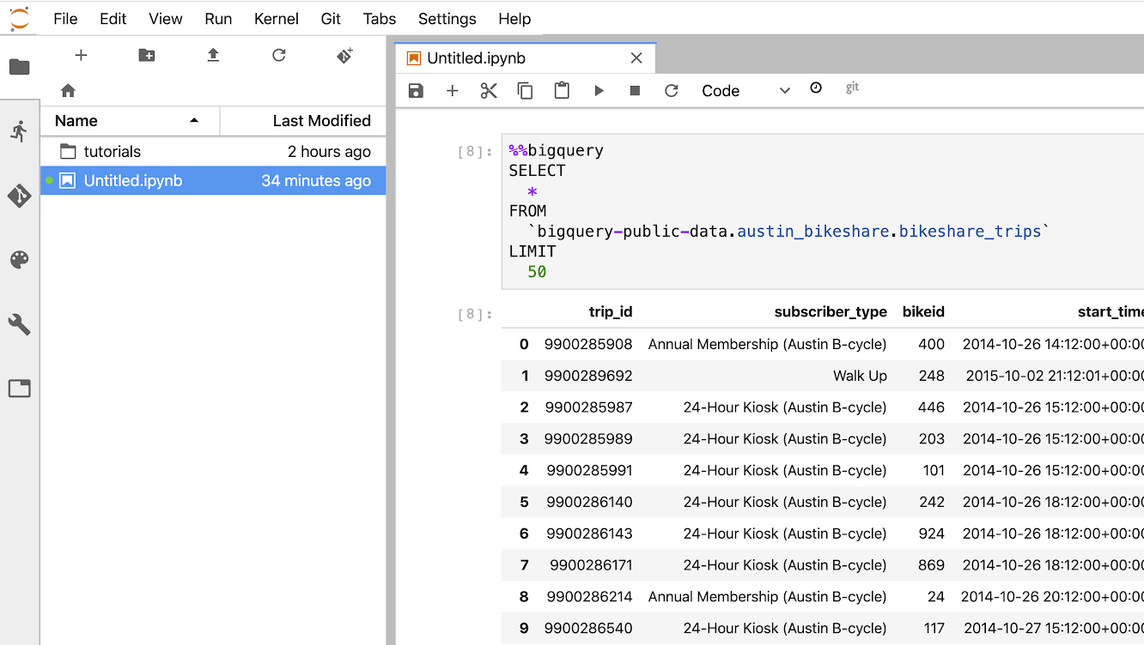
You can execute BigQuery commands from AI Platform Notebooks
Jupyter “magic” function
Useful for checking query validity
Viewing query output
But… can’t use query output for anything

Slide 14
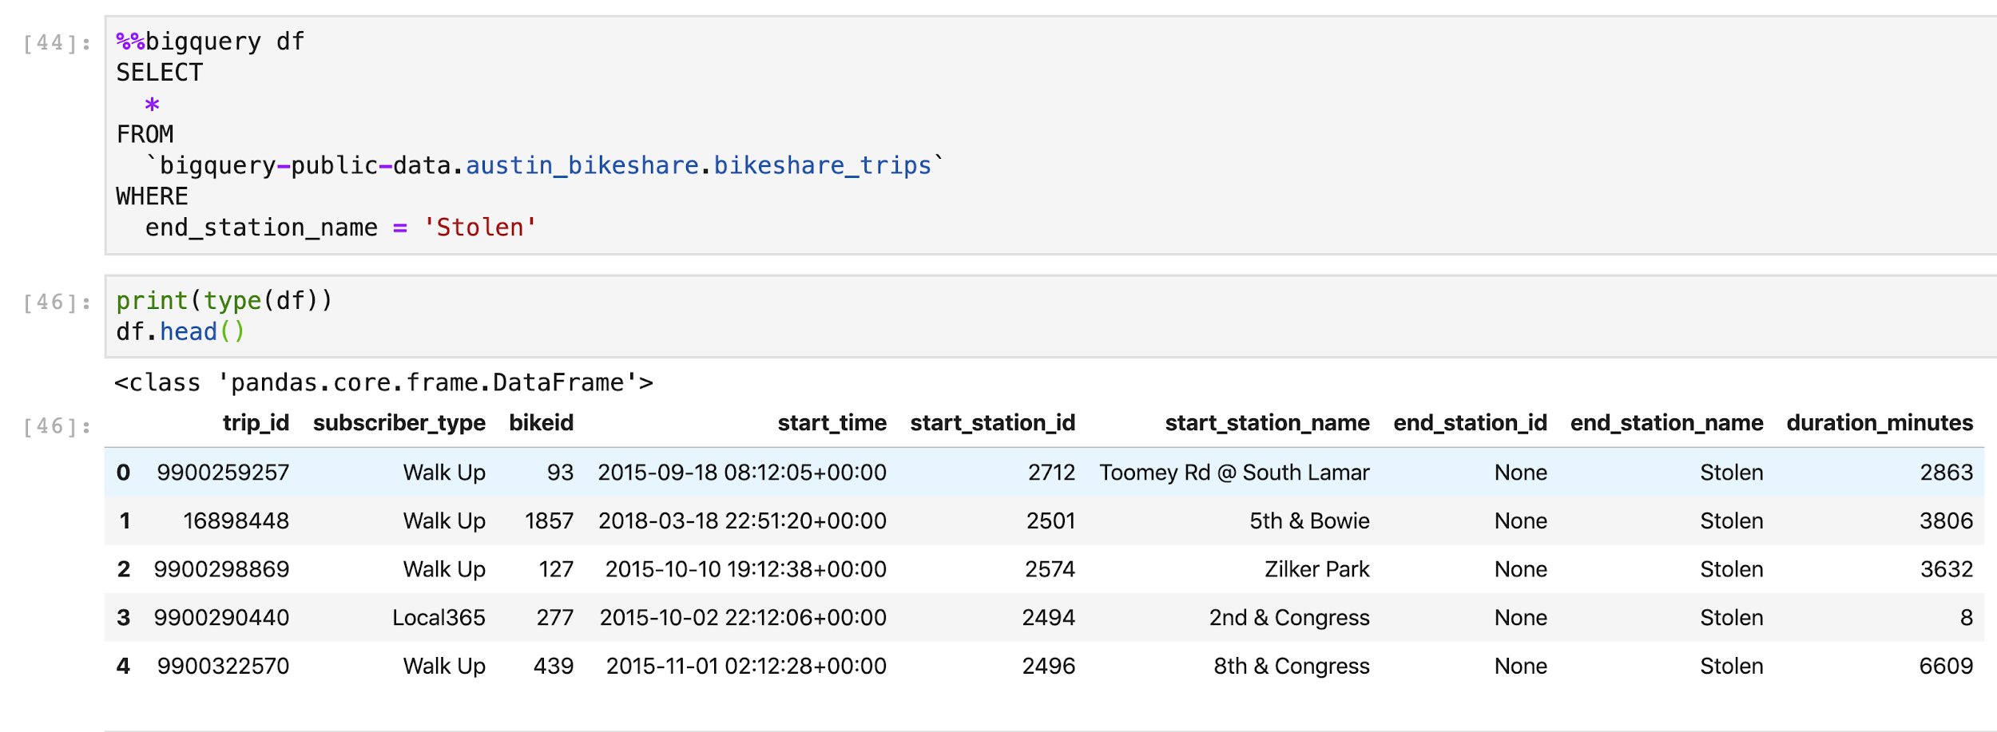
Can use the BigQuery API in Notebooks to return query results as a Pandas DataFrame
Pandas DataFrame

Slide 15
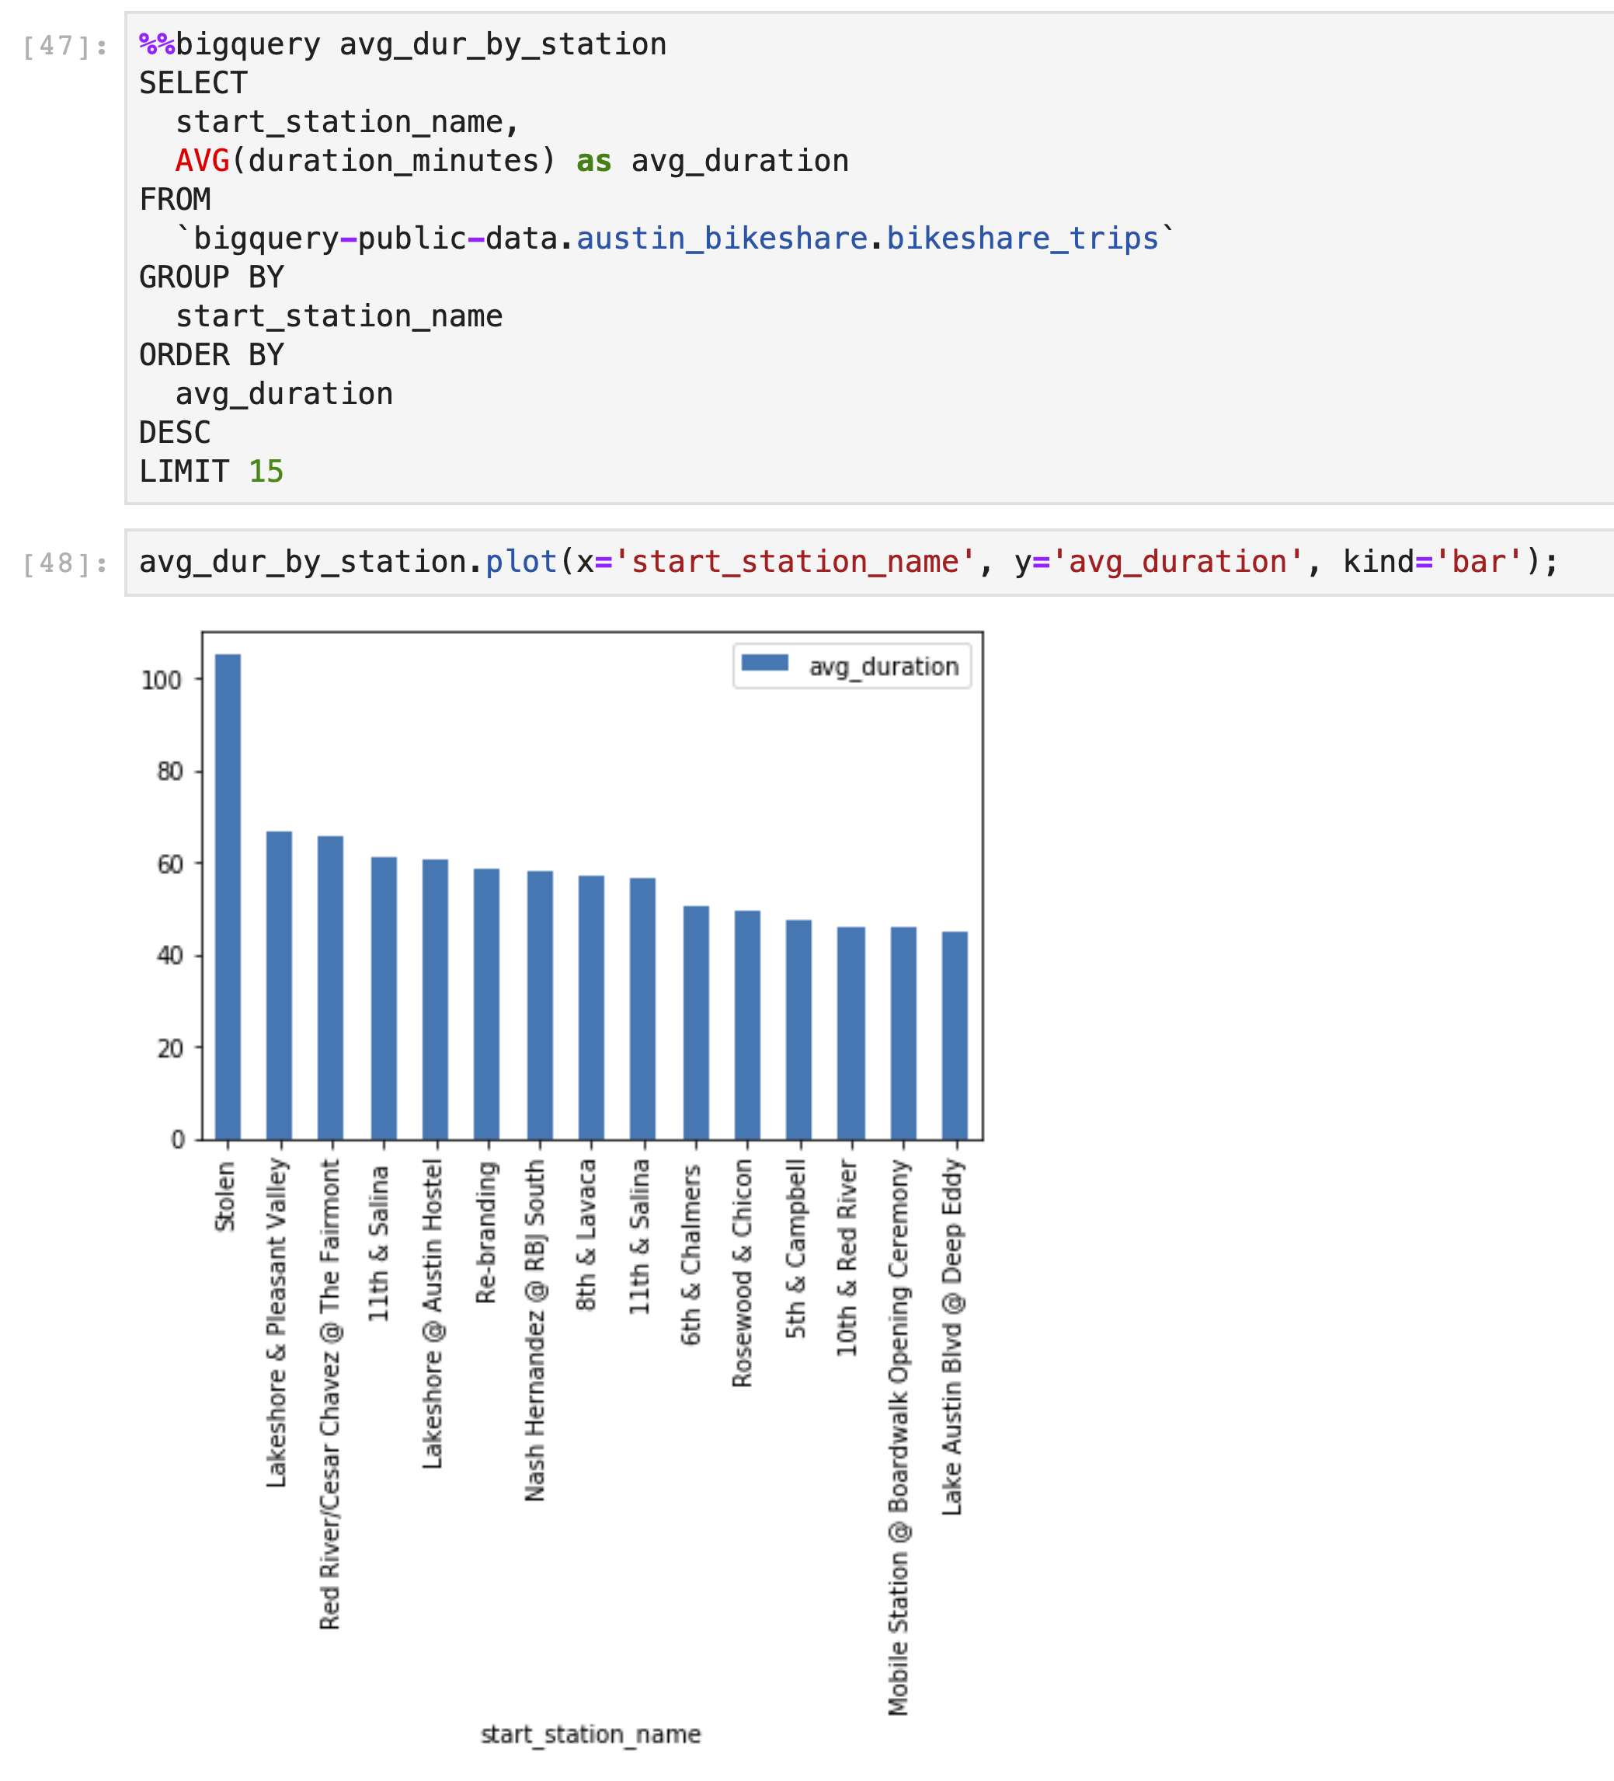
Pandas + BigQuery in Notebook rocks!

Slide 16
Lab
BigQuery in Jupyter Labs on AI Platform
Objectives
Instantiate a Jupyter notebook on AI Platform
Execute a BigQuery query from within a Jupyter notebook and process the output using Pandas
Notes:
BigQuery in Jupyter Labs on AI Platform
https://gcpstaging.qwiklabs.com/labs/30874/edit

Slide 17
Module Summary
AI Platform Notebooks are ideal for prototyping machine learning pipelines and models
Notebooks integrate nicely with BigQuery and other GCP services

